Slide 1


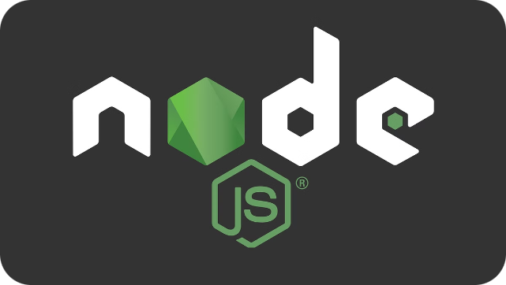


Introduction to Node.js and Express.js
Node.js is a runtime environment for executing JavaScript code outside of a web browser, while Express.js is a popular web application framework built on top of Node.js that simplifies the process of building web servers and APIs.
by Vivek Singh Parmar

Slide 2

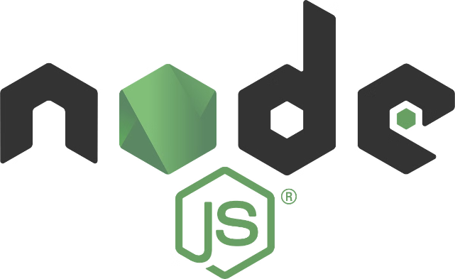
What is Node.js?
1
JavaScript Runtime
2
Asynchronous I/O
Node.js allows developers to run JavaScript code on the server-side, expanding the language's capabilities beyond the browser.
Node.js uses an event-driven, non-blocking I/O model, making it efficient for building scalable network applications.
3
Cross-Platform
Node.js can be used on various operating systems, including Windows, macOS, and Linux.

Slide 3
What is Express.js?
Web Application Framework
Routing and Middleware
Ecosystem and Community
Express.js is a minimalist and flexible web application framework for Node.js, providing a robust set of features for building web and mobile applications.
Express.js simplifies the process of handling HTTP requests and responses, as well as managing routing and middleware functionalities.
Express.js has a large and active community, with a vast ecosystem of third-party middleware and tools available.

Slide 4

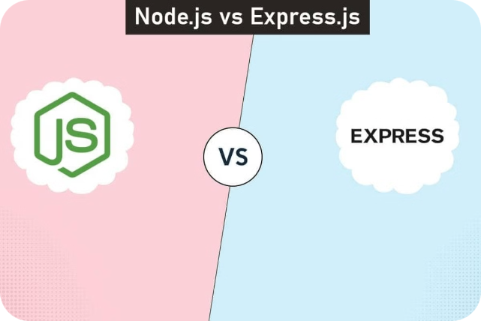
Differences in Purpose and Functionality
1
Node.js
A runtime environment for executing JavaScript code on the server-side, providing a platform for building scalable network applications.
2
Express.js
A web application framework built on top of Node.js, simplifying the process of building web servers and APIs.

Slide 5

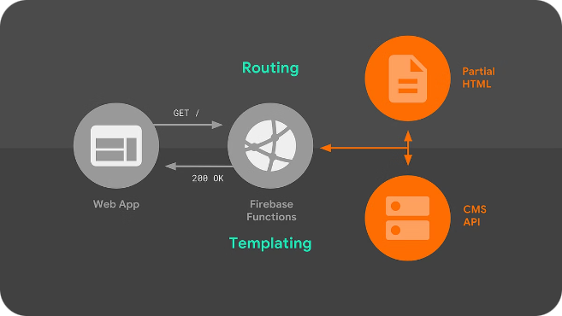
Differences in Routing and Middleware
Routing in Node.js
Routing in Express.js
Node.js provides a low-level API for handling HTTP requests, requiring developers to manually manage routing and middleware.
Express.js offers a more structured and robust routing system, with built-in support for handling HTTP methods, URL parameters, and middleware.
Middleware in Node.js
Middleware in Express.js
Node.js requires developers to manually manage middleware, such as parsing request bodies or handling errors.
Express.js provides a rich ecosystem of middleware functions that can be easily integrated into the application's request handling pipeline.

Slide 6





Differences in Handling HTTP Requests and Responses
HTTP Requests
Node.js provides a lower-level API for handling HTTP requests, while Express.js abstracts and simplifies the process.
HTTP Responses
Node.js requires manual management of HTTP responses, whereas Express.js offers a more intuitive and streamlined approach.
Middleware Integration
Express.js makes it easier to integrate middleware for tasks like parsing request bodies, handling errors, and more.

Slide 7





Differences in Handling Asynchronous Operations
Node.js Asynchronous Model
Node.js uses an event-driven, non-blocking I/O model to handle asynchronous operations, which can be more complex to manage.
Express.js Asynchronous Handling
Express.js builds on Node.js's asynchronous capabilities, providing a more streamlined approach to handling asynchronous operations.
Improved Productivity
Express.js abstracts away many of the low-level asynchronous details, allowing developers to focus more on building their application logic.

Slide 8

Conclusion and Key Takeaways
1
Node.js: A Powerful Runtime
2
Express.js: A Streamlined Framework
3
Complementary Technologies
Node.js provides a robust runtime environment for executing JavaScript on the server-side, enabling the creation of scalable network applications.
Express.js is a web application framework built on top of Node.js, simplifying the process of building web servers and APIs.
While Node.js and Express.js have distinct purposes, they work seamlessly together, providing a powerful combination for building modern web applications.

